Slide 1
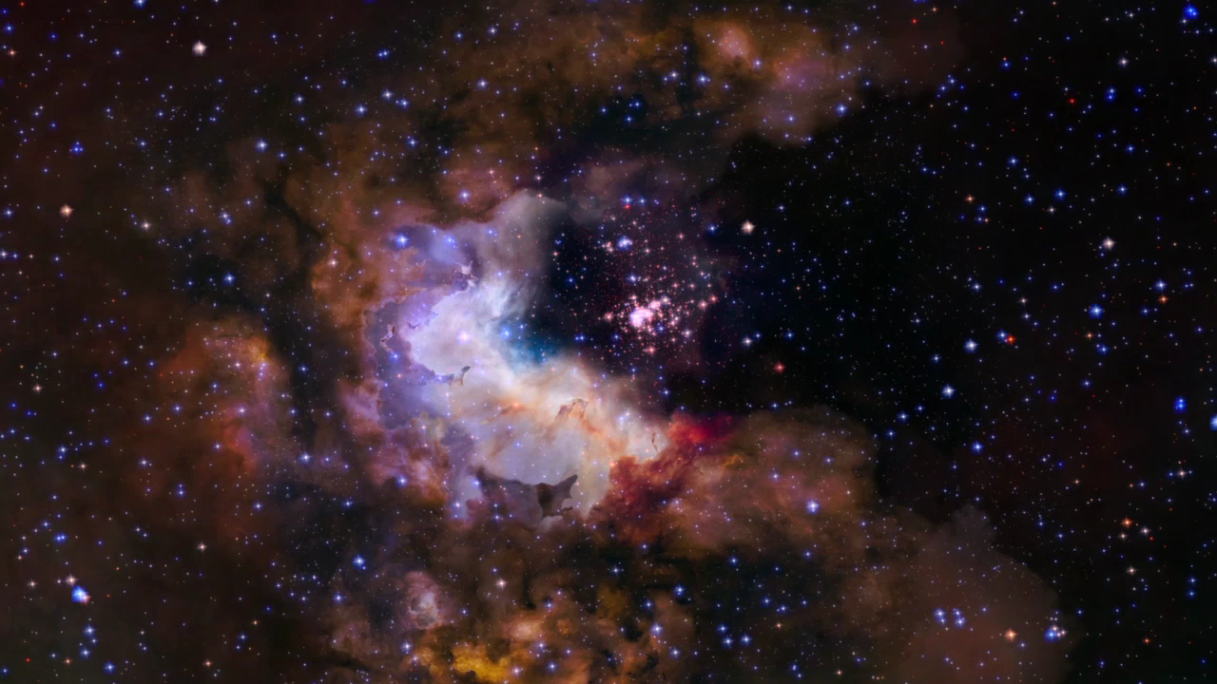
Notes:
Flight to Star Cluster Westerlund 2
This visualization provides a three-dimensional perspective on Hubble's 25th anniversary image of the nebula Gum 29 with the star cluster Westerlund 2 at its core. The flight traverses the foreground stars and approaches the lower left rim of the nebula Gum 29. Passing through the wispy darker clouds on the near side, the journey reveals bright gas illuminated by the intense radiation of the newly formed stars of cluster Westerlund 2. Within the nebula, several pillars of dark, dense gas are being shaped by the energetic light and strong stellar winds from the brilliant cluster of thousands of stars.

