Slide 1
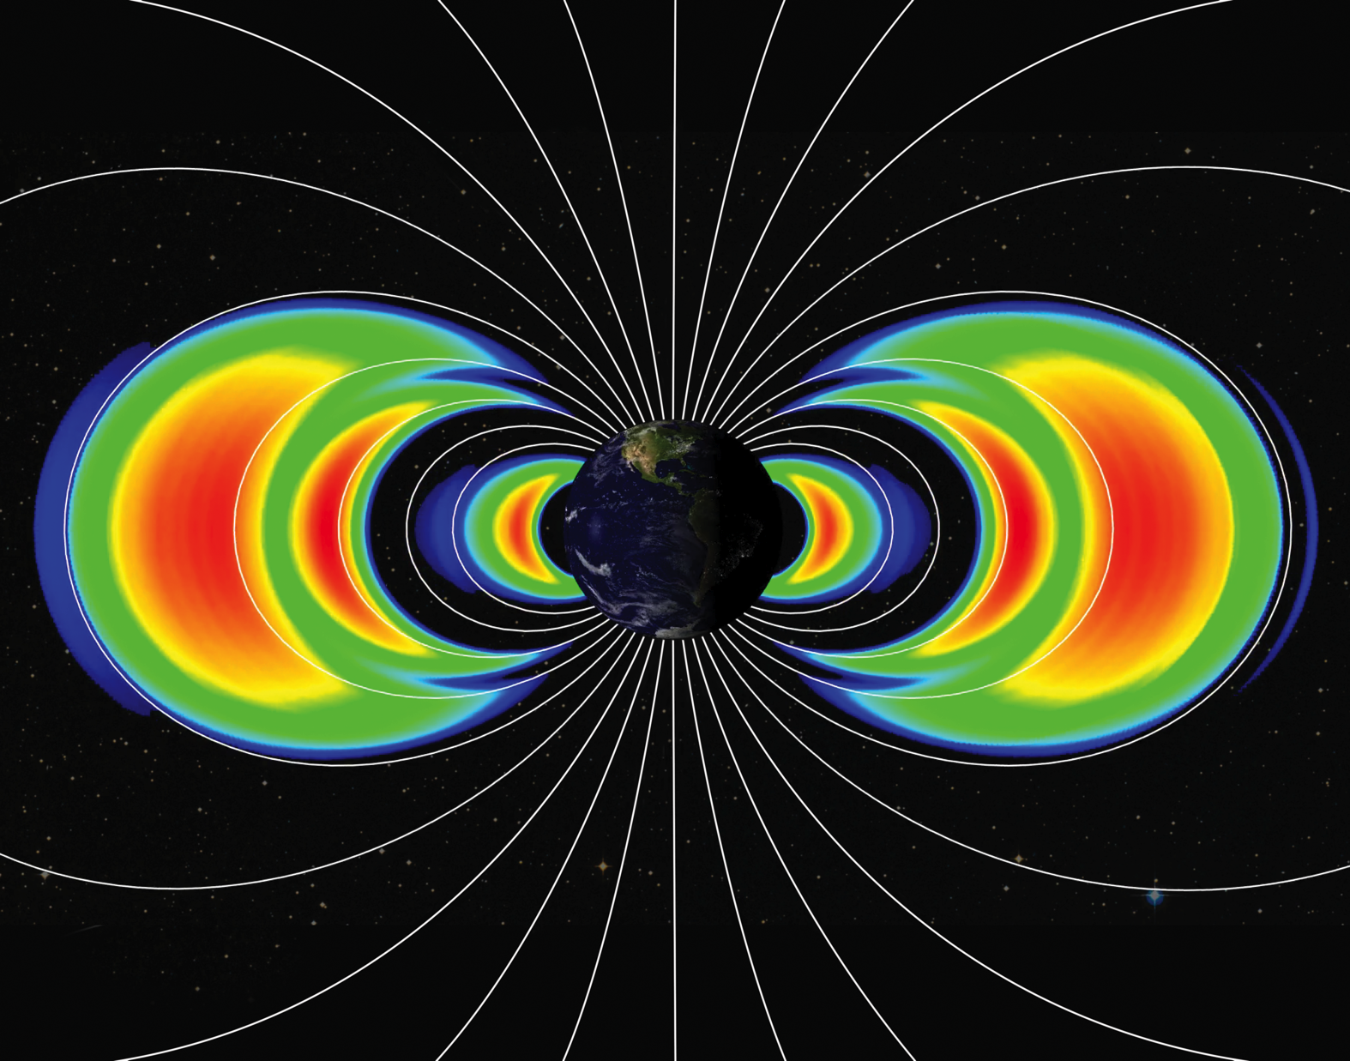
Notes:
Shortly after launch on August 30, 2012, particle detection instruments aboard NASA's twin Van Allen Probes revealed to scientists the existence of a new, transient, third radiation belt around Earth. In this image, three distinct radiation belts are represented as orange and red shades with the emergence of a second empty slot region [green], in between the second and new, outermost third belt.
Named after their discoverer James Van Allen, these belts are critical regions for modern society, which is dependent on many space-based technologies. The Van Allen belts are affected by space weather and can swell dramatically during solar storms. When this occurs, they can pose dangers to communications and global positioning system (GPS) satellites, as well as humans in space.
This discovery shows the dynamic and variable nature of the radiation belts and improves our understanding of how they respond to solar activity. Scientists observed the third belt for four weeks before a powerful interplanetary shock wave from the sun annihilated it. Data from the Van Allen Probes are important for the study of the effect of space weather on Earth, as well as the fundamental physical processes observed around other objects, such as planets in our solar system and distant nebulae.

