Slide 1
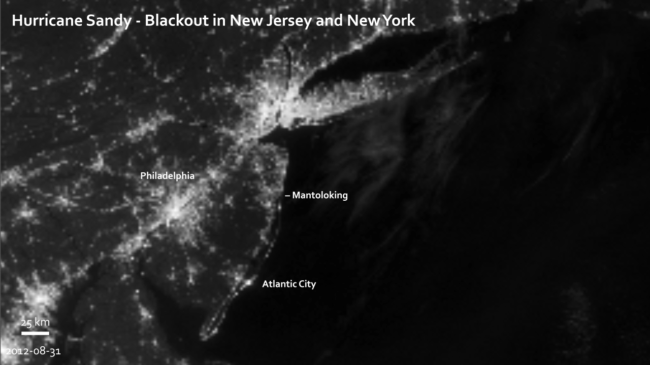
Notes:
In the days following landfall of Hurricane Sandy, millions remained without power. This pair of images shows the difference in city lighting across New Jersey and New York before (August 31, 2012), when conditions were normal, and after (November 1, 2012) the storm. Both images were captured by the Visible Infrared Imaging Radiometer Suite (VIIRS) “day-night band” onboard the Suomi National Polar-orbiting Partnership satellite, which detects light in a range of wavelengths and uses filtering techniques to observe signals such as gas flares, city lights, and reflected moonlight.
In Manhattan, the lower third of the island is dark on November 1, while Rockaway Beach, much of Long Island, and nearly all of central New Jersey are significantly dimmer. The barrier islands along the New Jersey coast, which are heavily developed with tourist businesses and year-round residents, are just barely visible in moonlight after the blackout.
Satellite: Suomi NPP
Instrument: VIIRS

