Slide 1
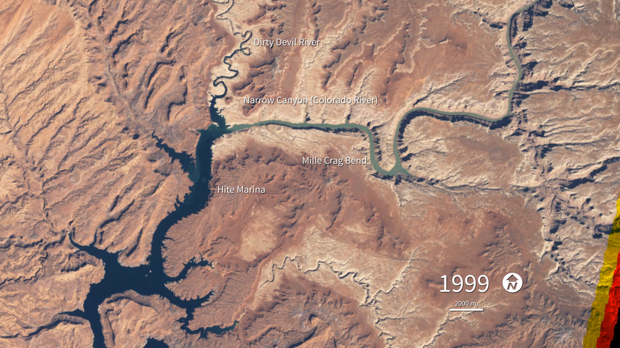
Notes:
Water Level in Lake Powell
Among the dams on the Colorado River is the Glen Canyon Dam, which creates Lake Powell. This series of natural-color Landsat images shows the dramatic drop in Lake Powell’s water level between 1999 and 2015 caused by prolonged drought and water withdrawals. At the beginning of the series, water levels were relatively high, and the water was a clear, dark blue. The sediment-filled river appeared green-brown. Dry conditions and falling water levels were unmistakable in the image from April 13, 2003, and again in early 2005 when water levels plummeted and the northwestern side branch of Lake Powell remained cut off from the rest of the reservoir.
In the latter half of the decade the lake level began to rebound. Significant amounts of snowfall over the winter of 2010–2011 meant more water for the lake. Regional snowfall in the spring of 2012, on the other hand, was abnormally low, and inflow to Lake Powell did not begin to increase in May 2012 as it had in previous years. Daily water levels between October 2012 and May 2013 were consistently five or more feet below the previous four years. Droughts in this region are not unusual; however, global warming is expected to make droughts more severe in the future.

