Slide 1
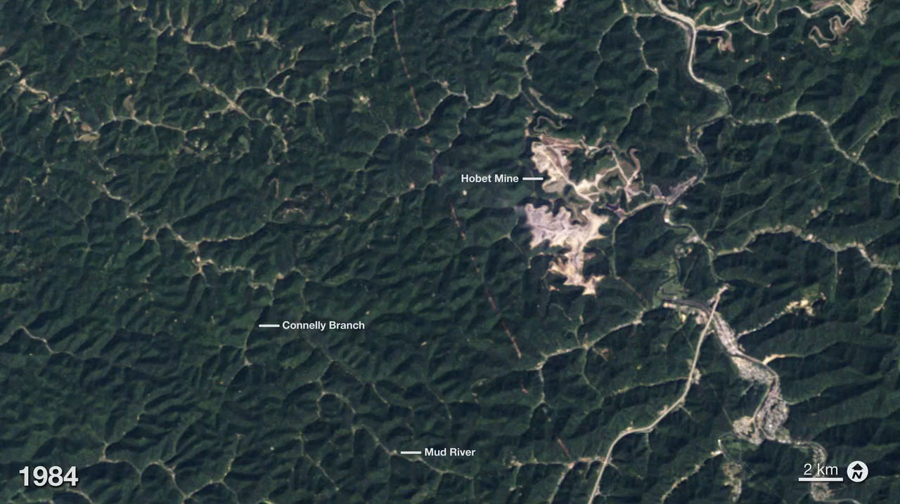
Notes:
Mountaintop Mining, West Virginia
These images illustrate the growth of the Hobet mine in Boone County, WV as it moves from ridge to ridge between 1984 and 2012. The natural forested landscape appears dark green, creased by steams and indented by hollows. Active mining areas however, appear off-white and areas being reclaimed with vegetation appear light green. The law requires coal operators to restore the land to its approximate original shape, but the rock debris generally can’t be securely piled as high or graded as steeply as the original mountaintop. There is always too much rock left over, and coal companies dispose of it by building <i>valley fills </i>in hollows, gullies, and streams. The most dramatic valley fill that appears in this series of images is what appears to be the near-complete filling of Connelly Branch from its source to its mouth at the Mud River between 1998 and 2002. Over the 28-year period, the disturbed area grew to more than 10,000 acres (15.6 square miles). While the image from 2012 shows apparent green-up of restored lands, it also shows expanded operations in the southwest and northeast. The resulting impacts to stream biodiversity, forest health, and ground-water quality are high, and may be irreversible.
For more information:
earthobservatory.nasa.gov/Features/WorldOfChange/hobet.php

