Slide 1
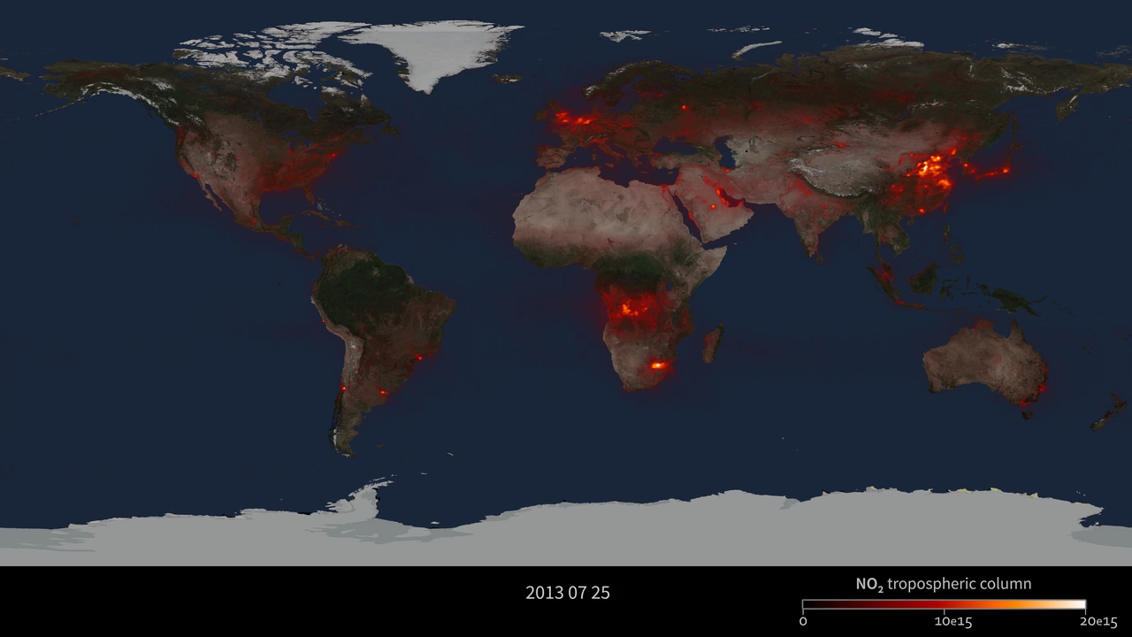
Notes:
Aura/OMI Nitrogen Dioxide, 6/2013 – 06/2014
Nitrogen Dioxide is a key component of urban air pollution. Most nitrogen dioxide is emitted by combustion (e.g., fossil fuels, wildfires). Major sources include industrial emissions, automobile traffic, forest and brush fires, microbiological soil emissions, lightning, and aircraft. More than half of the total nitrogen dioxide emissions are estimated to be anthropogenic, mainly from the burning of fossil fuels for energy production, transportation, and industrial activities. Nitrogen dioxide has a relatively short lifetime (about a day) and is therefore concentrated near its sources. This sequence of daily images from July 2013 to July 2014, shows the global perspective of tropospheric nitrogen dioxide as measured by the Ozone Measuring Instrument (OMI) flying aboard NASA's Aura spacecraft.
Aura – Ozone Monitoring Instrument (OMI)
Nitrogen dioxide (NO2) is a key component of urban air pollution. The nitrogen oxides ("NOx" of which NO2 is one component) are emitted from any combustion process. Coal- and gas-fired power plants and vehicles constitute the major anthropogenic (human-produced) sources. Forest fires and lightning are natural sources of NO2, but globally it is clear that anthropogenic sources dominate. High levels of NO2 are significant as they are associated with: 1) haze that reduces visibility; 2) irritation of the eyes, nose, throat, and lungs; 3) acid rain; 4) reduced terrestrial plant growth; 5) oxygen-depleting algal blooms; and 6) corrosion of building materials.
Several striking observations can be made from this global view of the NO2 air pollutant. First, the dominant NO2 source regions correspond primarily to areas with high population and large industry, for example, eastern China, northern Europe, and the eastern United States. Because most electricity is produced by burning fossil fuels in power plants that emit NO2, these hot spots are strongly correlated with electricity usage and fuel sources.
Second, urban centers show up as smaller hot spots. High vehicle traffic leads to elevated NO2. For example, Mexico City, Tokyo, and Los Angeles are all clearly marked by their NO2 plume. If one zooms in to California, the north-south transit corridor of the I-5 freeway is actually visible from space via its NO2 signature.
Third, a clear seasonal pattern is apparent. In the northern hemisphere winter, peak NO2 is much higher in all the northern hemisphere hot spots. This is attributed both to heavier use of combustion power plants for wintertime home heating, as well as the fact that NO2 stays in the air longer in the winter. The atmospheric lifetime of NO2 is driven primarily by reactions initiated by sunlight. With less sunlight in the wintertime, reactions that break down NO2 are not easily initiated, and the NO2 is removed more slowly from the atmosphere. Urban areas report NO2 air quality standard "exceedance" events, when the level of this pollutant is higher than deemed safe by environmental agencies. This happens most frequently during the cold winter months.

