Slide 1
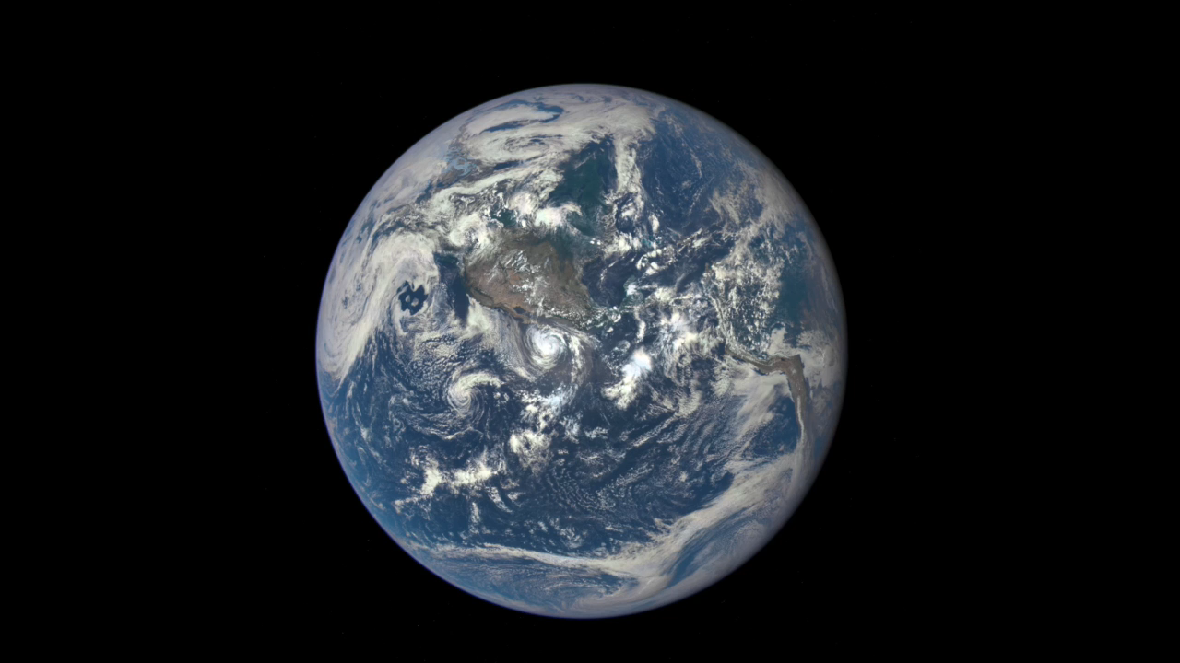
Notes:
An EPIC View of Earth and the Moon
On July 16, 2015, a NASA camera onboard the Deep Space Climate Observatory (DSCOVR) satellite returned a series of images of the entire sunlit side of Earth and the moon from its orbit at the first Lagrange point (L1), about 1,000,000 miles (1,609,344 kilometers) from Earth. This image series, taken by the Earth Polychromatic Imaging Camera (EPIC), shows the far side of the moon, illuminated by the sun, as it crossed between DSCOVR and Earth. The effects of sunlight scattered by air molecules gives Earth a characteristic bluish tint.
The images were generated by combining red, blue, and green exposures taken by EPIC in quick succession (about 30 seconds apart). Because the moon moved in relation to Earth between exposures, a thin green offset appears on the right side of the moon. This natural lunar movement also produces a slight red and blue offset on the left side of the moon. At the time of this writing, regular data acquisition is scheduled to begin in September 2015 with images available every day, 12 to 36 hours after they are acquired by EPIC. Data from EPIC will be used to measure ozone and aerosol levels in Earth’s atmosphere, cloud height, vegetation properties, and the ultraviolet reflectivity of Earth. NASA will use these data for a number of Earth science applications, including dust and volcanic ash maps of the entire planet.
The primary objective of DSCOVR, a partnership between NASA, the National Oceanic and Atmospheric Administration (NOAA), and the U.S. Air Force, is to maintain the nation’s real-time solar wind monitoring capabilities, which are critical to the accuracy and lead time of space weather alerts and forecasts from NOAA.
For more information, visit
www.nesdis.noaa.gov/DSCOVR

