Slide 1
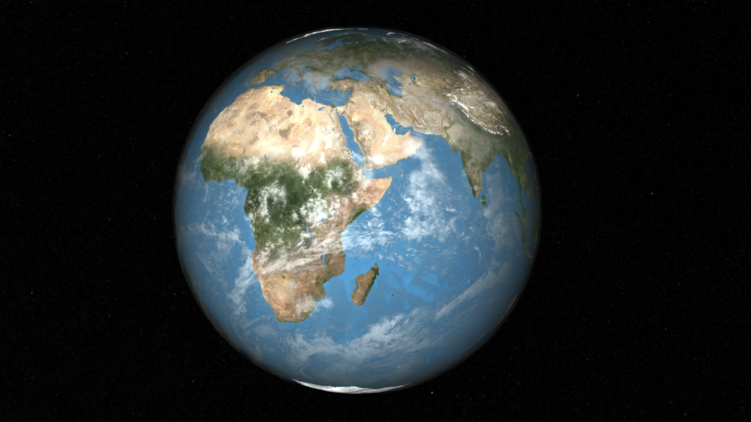
Notes:
Monitoring Chimpanzee Habitats in Western Tanzania
In partnership with the Jane Goodall Institute (JGI), NASA scientists have provided assistance in the monitoring, forecasting, and conservation of natural resources in regions surrounding the Gombe National Park in Tanzania. Between 1972 and 1999, significant deforestation had occurred in the regions outside the boundary of the Gombe National Park to the detriment of the park's chimpanzee population as well as to the that of the villagers living in the region.
This visualization shows one location of the area in western Tanzania where the Jane Goodall Institute is working. After focusing on the region to the southeast of the Gombe National Park, this visualization shows the change in forest cover between 1972 and 1999. Forested areas are shown in shades of green; non-forested regions are shown in shades of brown. In 2005, JGI initiated a forest monitoring program training and in 2009 equipped community members with GPS-enabled Android smart phones and tablets to report their observations on forests threats and wildlife. Combining NASA remote sensing data with citizen science observations facilitated local people to develop and implement land use plans, leading to improved decision making and facilitating the establishment of village forest reserves.
For more information, visit:
http://svs.gsfc.nasa.gov/4483

