Slide 1
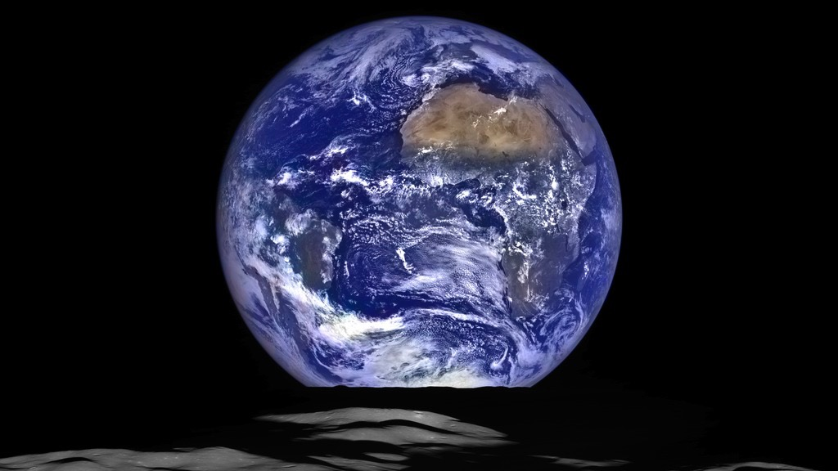
Notes:
LROC Earthset
The Earth straddling the limb of the Moon, as seen from above Compton crater (51.8°N, 124.1°E). The center of the Earth in this view is 4.05°S, 12.48°W, about 1100 kilometers due south of Sierra Leone. The large tan area in the upper right is the Sahara desert, and just beyond is the Arabian Peninsula. The Atlantic and Pacific coasts of South America are visible to the left. WAC E1199291151C (Earth only), NAC M1199291564LR (Earth and Moon); sequence start time 12 October 2015 12:18:17.384 UTC.
This image of the Earth setting behind the lunar horizon was taken by the Lunar Reconnaissance Orbiter Camera (LROC) on October 12, 2015. The image is a composite of pixels from the narrow-angle (NAC) and wide-angle (WAC) sensors.

