Slide 1
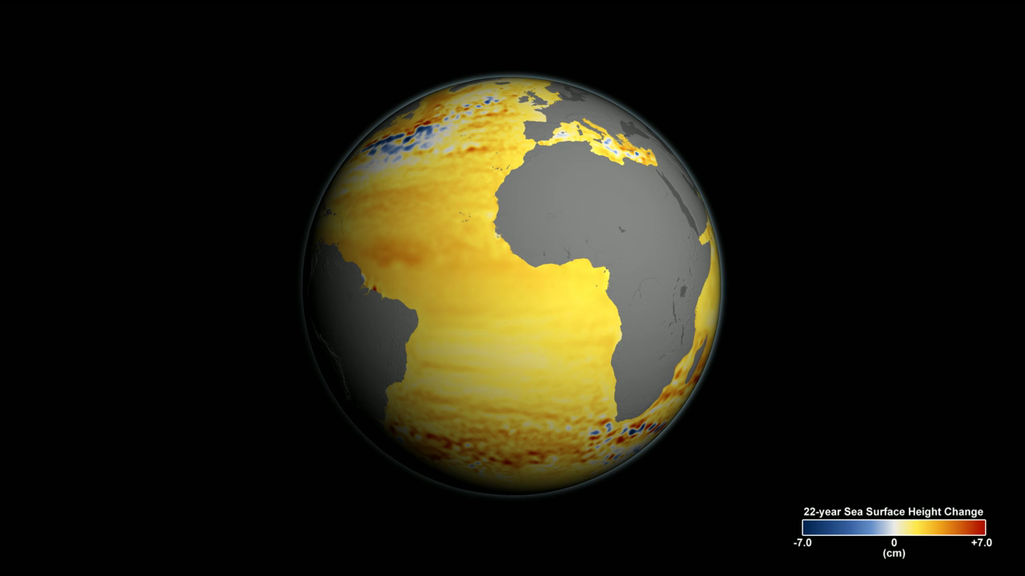
Notes:
22-Year Sea Level Rise
Sea level rise is caused primarily by two factors related to global warming: the added water from melting land ice and the expansion of seawater as it warms. Seas around the world have risen an average of nearly 3 inches since 1992, with some locations rising more than 9 inches due to natural variation, according to the latest satellite measurements from NASA and its partners.
This visualization shows total sea level change between 1992 and 2014, based on data collected from the TOPEX/Poisedon, Jason-1, and Jason-2 satellites. Blue regions are where sea level has gone down, and orange/red regions are where sea level has gone up. The color range for this visualization is -7 centimeters to +7 centimeters (-2.76 inches to +2.76 inches), though measured data extends above and below 7 centimeters. This particular range was chosen to highlight variations in sea level change.
For more information, visit
sealevel.jpl.nasa.gov

