Slide 1
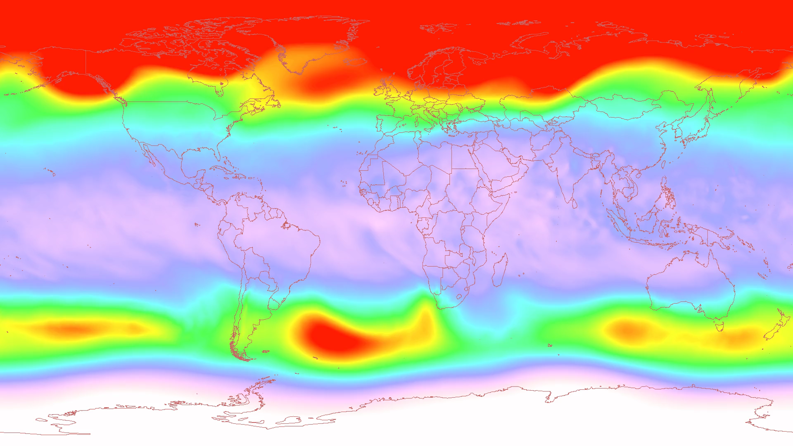
Notes:
Antarctic Ozone 2004
The Antarctic ozone hole is caused by human-produced chlorine-containing chlorofluorocarbons (CFCs) and bromine-containing halons. These compounds had a variety of commercial uses, including hair sprays, refrigerants, and fire suppressants.
The ozone hole develops during the southern hemisphere winter and spring. Winter begins as the sun sets over Antarctic in the March-April period. Because of the absence of sunlight during the dark polar night, the lower stratosphere cools off. The top left panel shows temperature. In the August-September period, temperatures are below -70 degrees Celsius over a wide region.

Slide 2
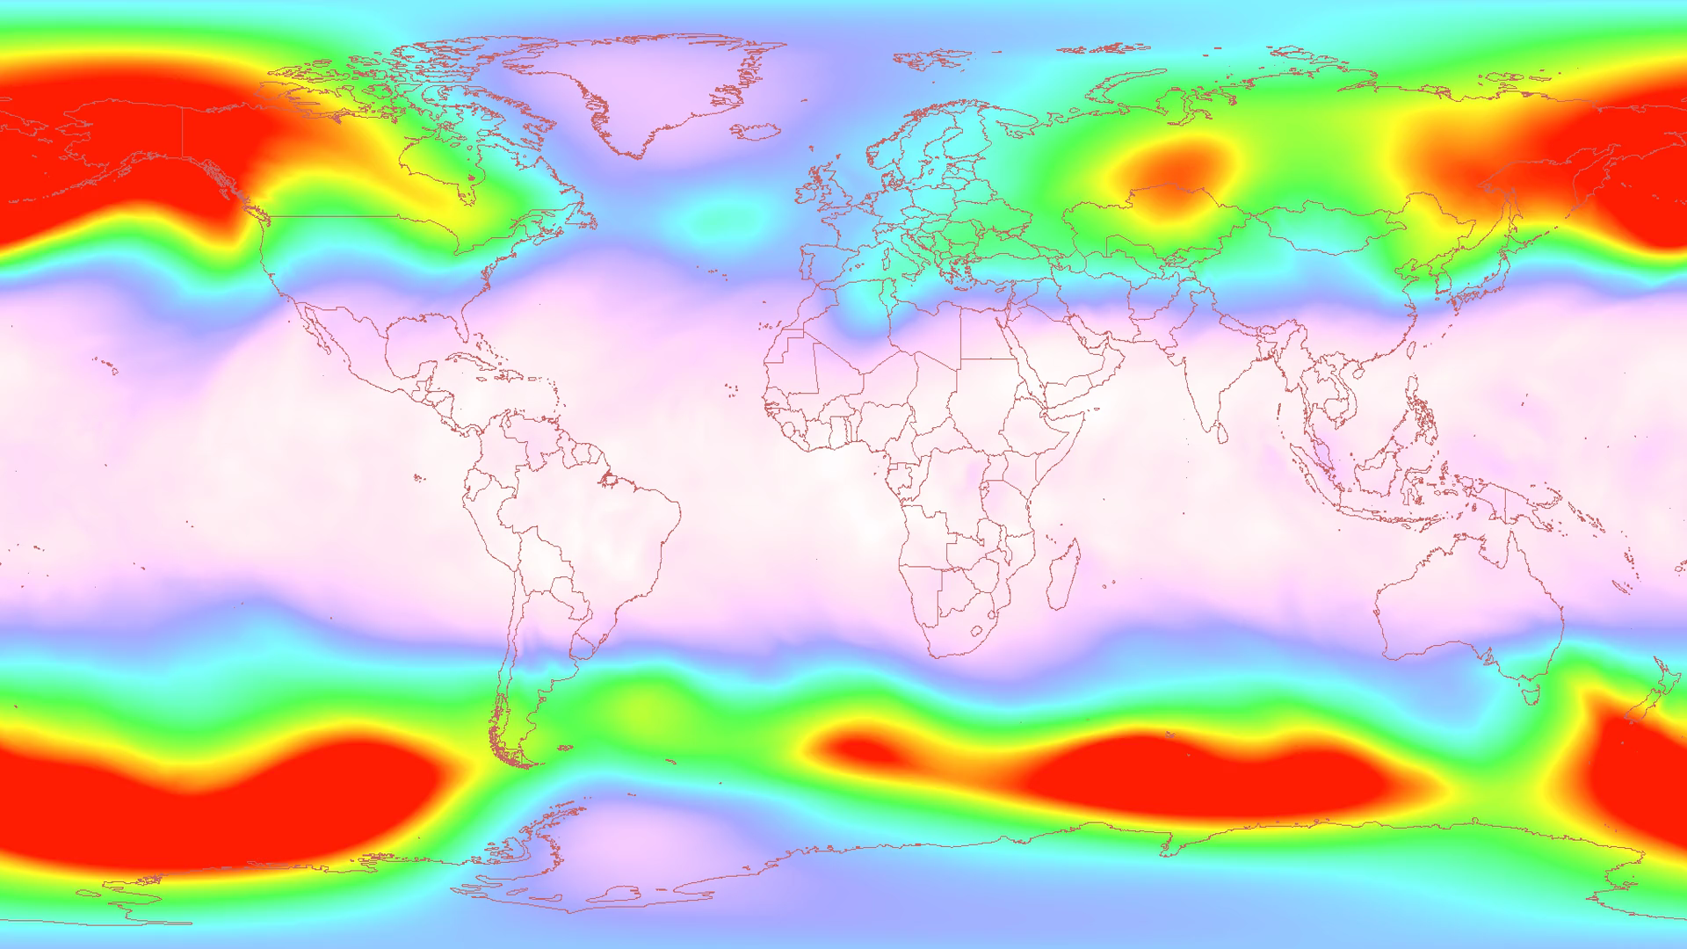
Notes:
Antarctic Ozone 2005
The Antarctic ozone hole is caused by human-produced chlorine-containing chlorofluorocarbons (CFCs) and bromine-containing halons. These compounds had a variety of commercial uses, including hair sprays, refrigerants, and fire suppressants.
The ozone hole develops during the southern hemisphere winter and spring. Winter begins as the sun sets over Antarctic in the March-April period. Because of the absence of sunlight during the dark polar night, the lower stratosphere cools off. The top left panel shows temperature. In the August-September period, temperatures are below -70 degrees Celsius over a wide region.

