Slide 1
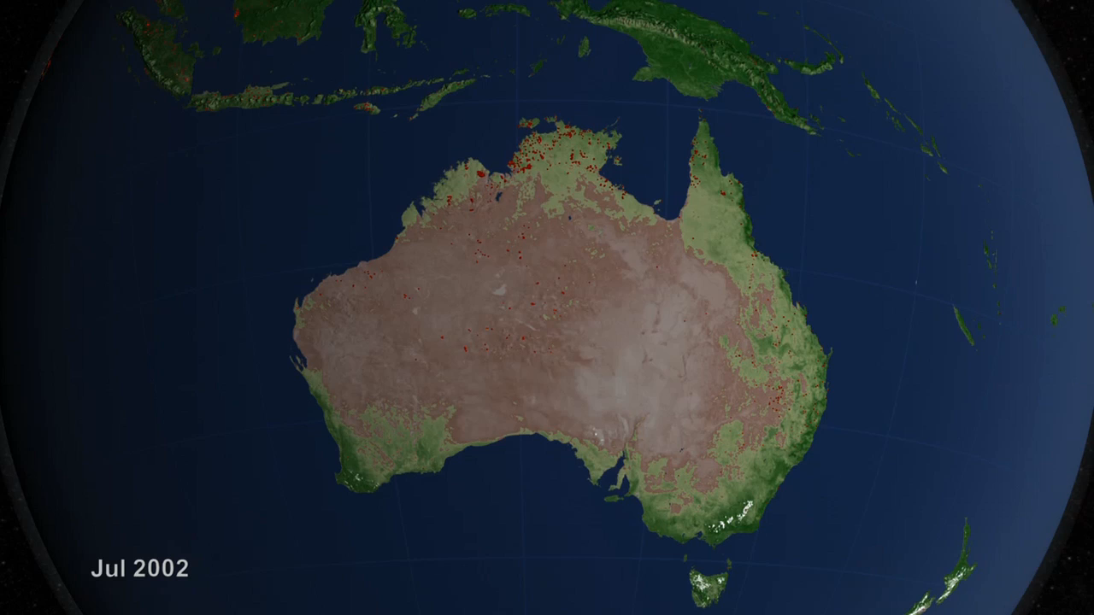
Notes:
Global Fire Tour
Fires can take place just about anywhere on the planet, but some locales seem more prone to fires than others. Observations from space have shown that approximately 70% of the world’s fires occur in Africa alone. This visualization leads you through a global tour of fires from July 2002–July 2011. Fires can result from either natural processes, such as ignition by lighting strikes; or human activity, such as burning vegetation for agricultural purposes. As an example, almost all of the fires in the Amazon are the direct result of human activity, including slash-and-burn agriculture. Instruments such as the Moderate Resolution Imaging Spectroradiometer (MODIS) aboard NASA’s Aqua and Terra satellites detect fires from space.
SVS Animation 3868 - Global Fire Observations and MODIS NDVI

