Slide 1
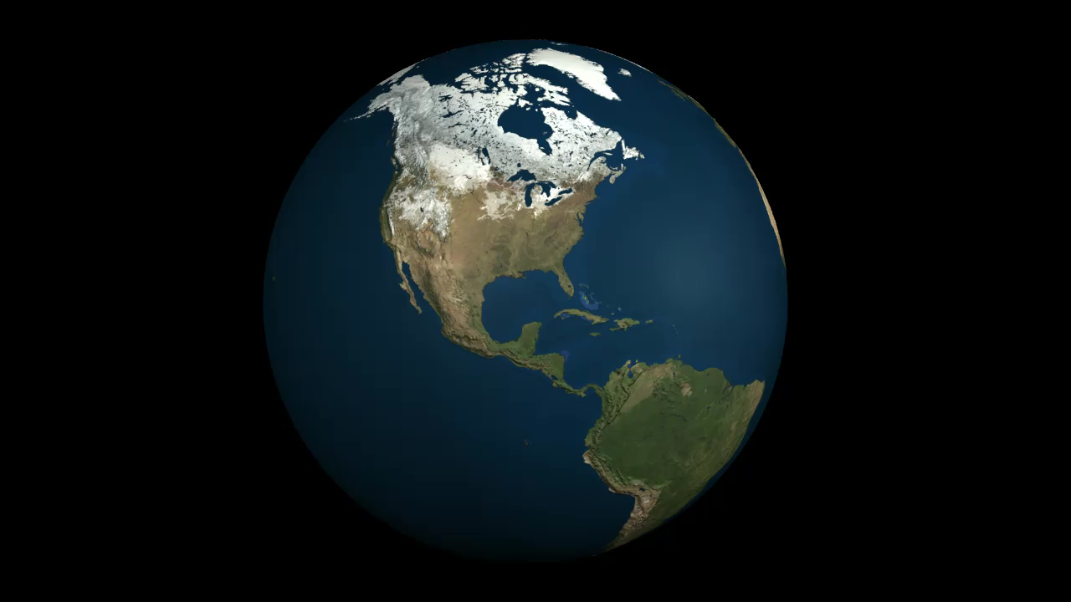
Notes:
Greenland Melt Season 2007
This animation displays two geophysical data products of the Greenland ice sheet side-by-side, showing data from the Moderate Resolution Imaging Spectroradiometer (MODIS) on the left side and data from the Quick Scatterometer (QuikSCAT) on the right. The 2007 melt season is shown twice. In the first sequence, MODIS surface temperature is compared with several categories of QuikSCAT melt between March 15th and October 13th, 2010. During this sequence, active melt detected by QuikSCAT is shown in light blue, reduced melt is medium blue, and completed melt is dark blue. For the MODIS, surface temperature is shown with the color scale -- red indicates a surface temperature greater than -1 degree Celsius. As MODIS shows warmer surface temperature as the melt season progresses, QuikSCAT consistently identifies the corresponding melt.
^{Satellite: Terra. Quikscat}
^{Instruments: MODIS. Seawinds}

