Slide 1
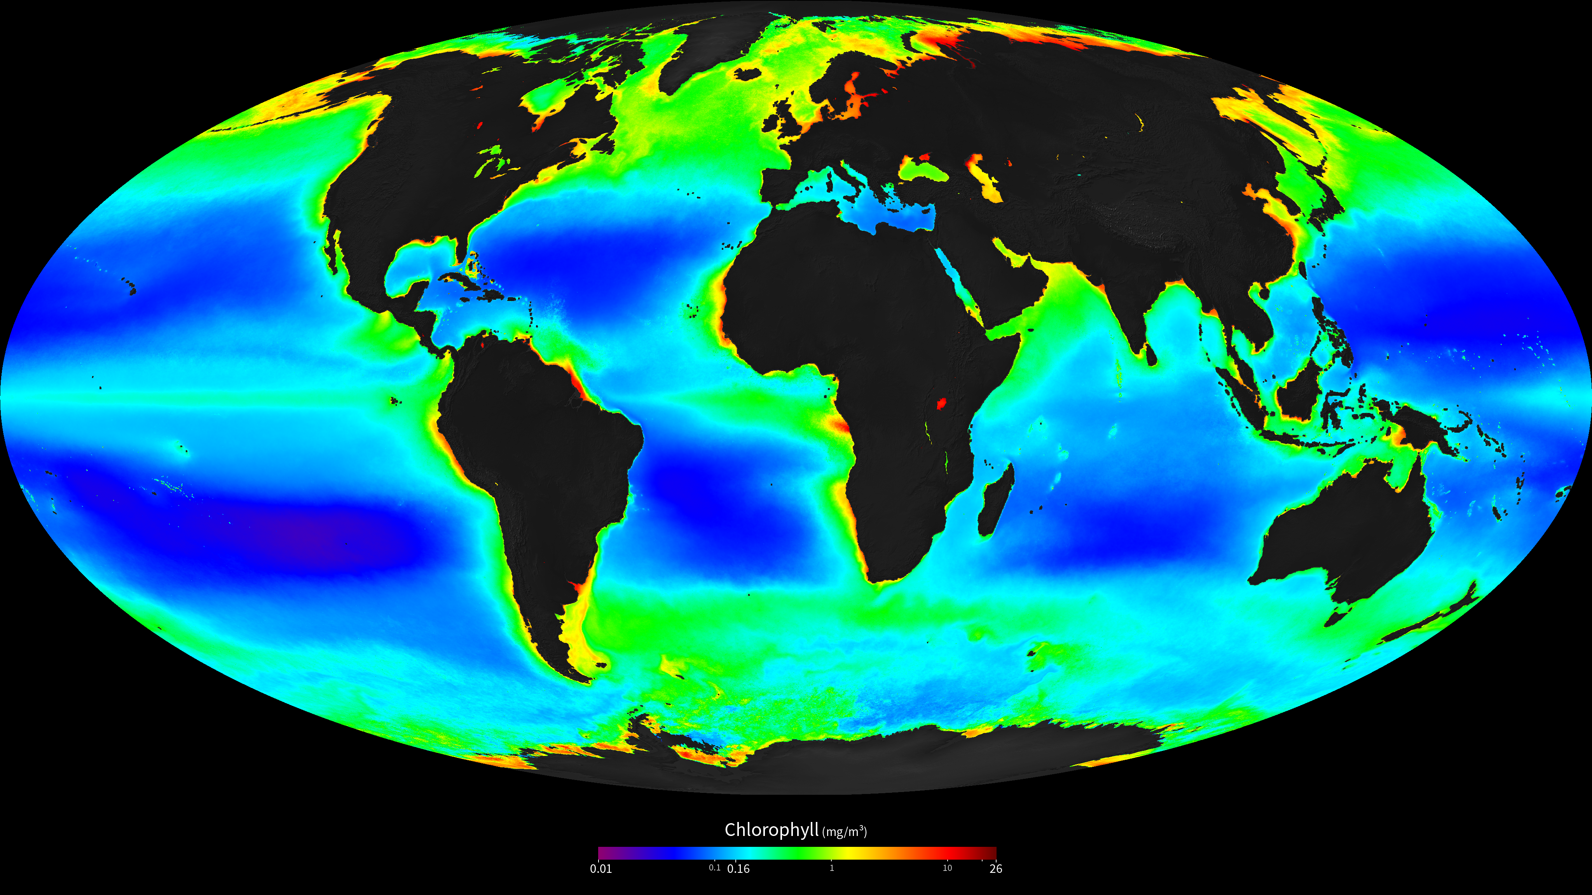
Notes:
SeaWIFS full mission composite
Ocean chlorophyll concentration averaged over the full mission–4 Sep 1997 to 30 Nov 2010.
The SeaWiFS instrument was launched by Orbital Sciences Corporation on the OrbView-2 (a.k.a. SeaStar) satellite in August 1997, and collected data from September 1997 until the end of mission in December 2010. SeaWiFS had 8 spectral bands from 412 to 865 nm. It collected global data at 4 km resolution, and local data (limited onboard storage and direct broadcast) at 1 km. The mission and sensor were optimized for ocean color measurements, with a local noon (descending) equator crossing time orbit, fore-and-aft tilt capability, full dynamic range, and low polarization sensitivity.
For more information see:
oceancolor.gsfc.nasa.gov

Slide 2
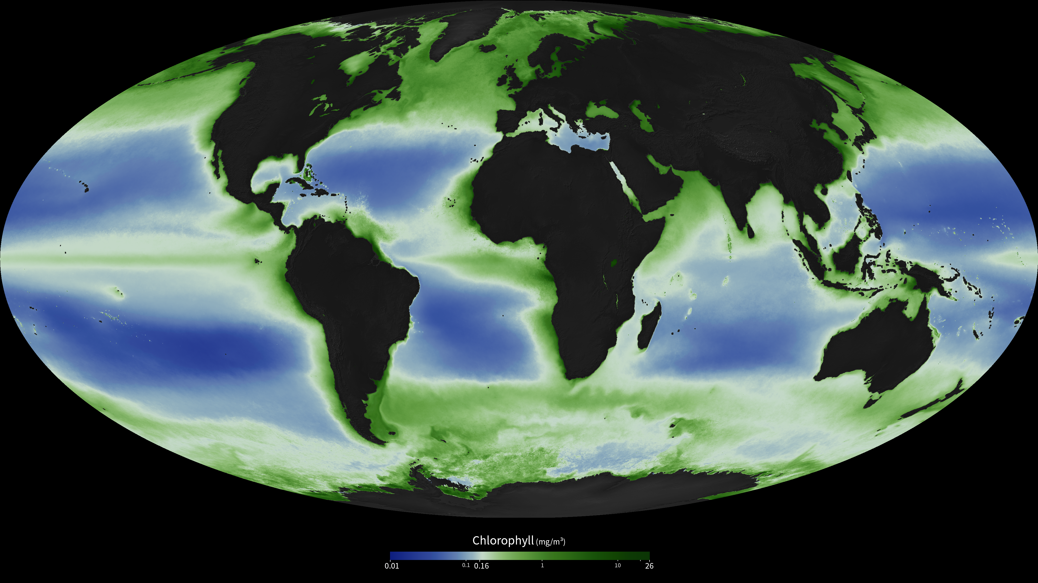
Notes:
SeaWIFS full mission composite
Ocean chlorophyll concentration averaged over the full mission–4 Sep 1997 to 30 Nov 2010.
The SeaWiFS instrument was launched by Orbital Sciences Corporation on the OrbView-2 (a.k.a. SeaStar) satellite in August 1997, and collected data from September 1997 until the end of mission in December 2010. SeaWiFS had 8 spectral bands from 412 to 865 nm. It collected global data at 4 km resolution, and local data (limited onboard storage and direct broadcast) at 1 km. The mission and sensor were optimized for ocean color measurements, with a local noon (descending) equator crossing time orbit, fore-and-aft tilt capability, full dynamic range, and low polarization sensitivity.
For more information see:
oceancolor.gsfc.nasa.gov

