Slide 1
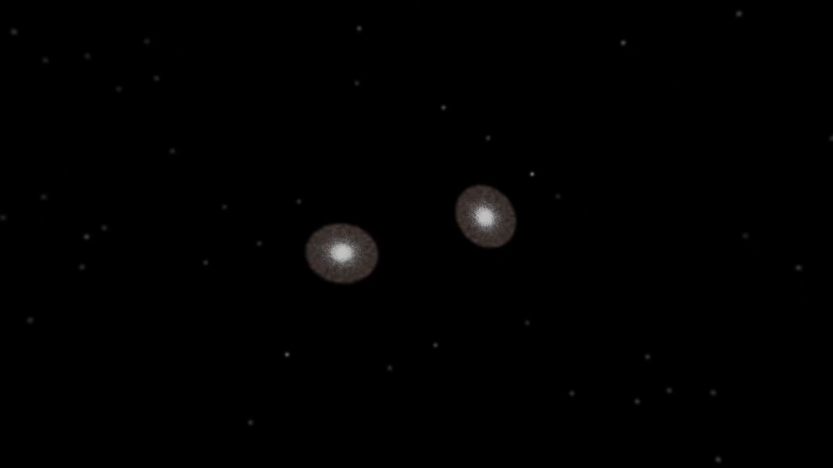
Notes:
Galaxy Collisions: Simulation vs Observations
An image of a galaxy collision captures only one stage of billion-year-long collision process. This visualization of a galaxy collision supercomputer simulation shows the entire collision sequence, and compares the different stages of the collision to different interacting galaxy pairs observed by NASA's Hubble Space Telescope. With this combination of research simulations and high resolution observations, these titanic crashes can be better understood.

