Slide 1
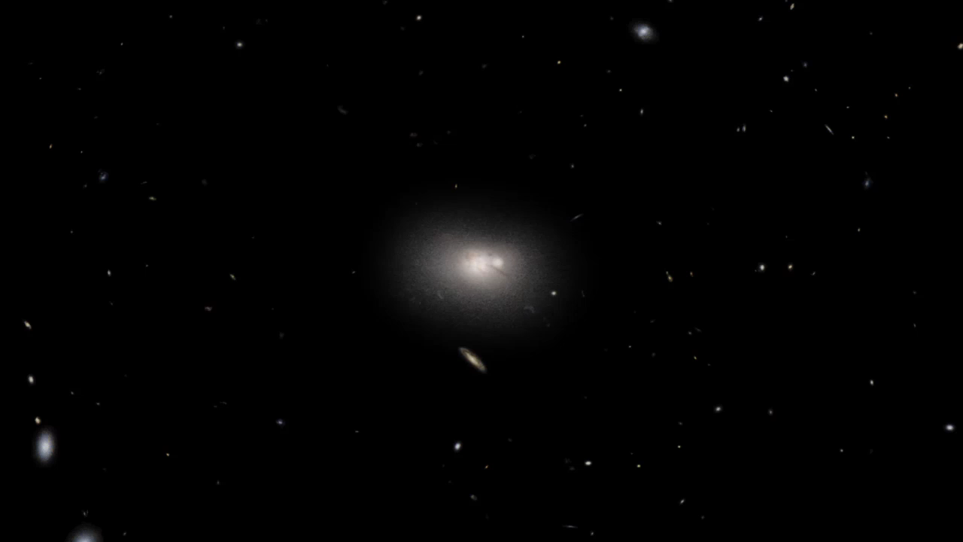
Notes:
Active Galaxy Hercules A
This visualization envisions a three-dimensional look at the combined visible light (Hubble Space Telescope) and radio emission (Very Large Array) from Hercules A. The supermassive black hole in the galaxy's core spews out strong jets of energetic particles that produce enormous lobes of radio emission. The size of the radio lobes dwarfs the large galaxy and extends throughout the volume of the galaxy group.

