Slide 1
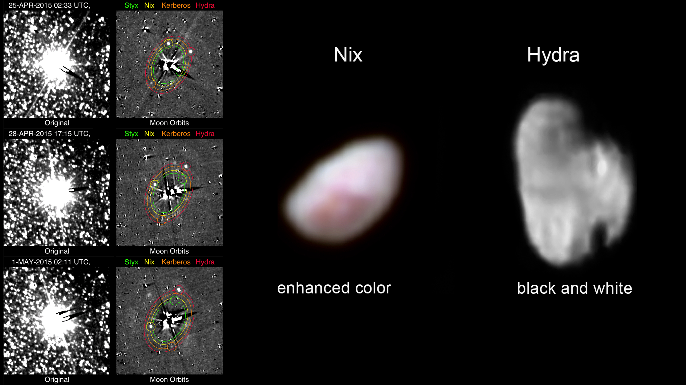
Notes:
Pluto's Smaller Moons
For the first time, NASA's New Horizons spacecraft has photographed Kerberos and Styx—the smallest and faintest of Pluto's five known moons. The images detecting Kerberos and Styx shown here (left) were taken with New Horizons' Long Range Reconnaissance Imager (LORRI), from April 25-May 1, 2015. The images were extensively processed to reduce the bright glare of Pluto and Charon and largely remove the dense field of background stars. The faint satellites, whose positions and orbits are shown, can be see in the on the left, right column.
Pluto's moon Nix (center), shown here in enhanced color as imaged by the New Horizons Ralph instrument, has a reddish spot that has attracted the interest of mission scientists. The data were obtained on the morning of July 14, 2015. At the time the observations were taken New Horizons was about 102,000 miles (165,000 km) from Nix. The image shows features as small as approximately 2 miles (3 kilometers) across on Nix, which is estimated to be 26 miles (42 kilometers) long and 22 miles (36 kilometers) wide.
Pluto's small, irregularly shaped moon Hydra (right) is revealed in this black and white image taken from New Horizons' LORRI instrument on July 14, 2015, from a distance of about 143,000 miles (231,000 kilometers). Features as small as 0.7 miles (1.2 kilometers) are visible on Hydra, which measures 34 miles (55 kilometers) in length.
For more information, see:
pluto.jhuapl.edu

