Slide 1
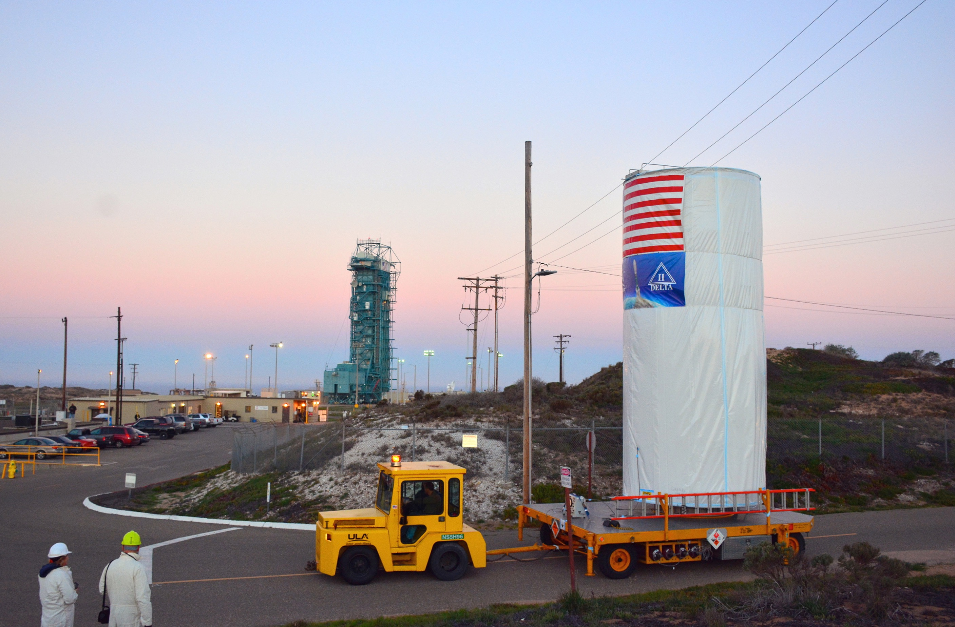
Notes:
SMAP in a can
NASA's Soil Moisture Active Passive satellite is transported across Vandenberg Air Force Base in California to Space Launch Complex 2, where it will be mated to a Delta II rocket for launch, targeted for Jan. 29. SMAP will provide global measurements of soil moisture and its freeze/thaw state.
For more information:
http://smap.jpl.nasa.gov

