Slide 1
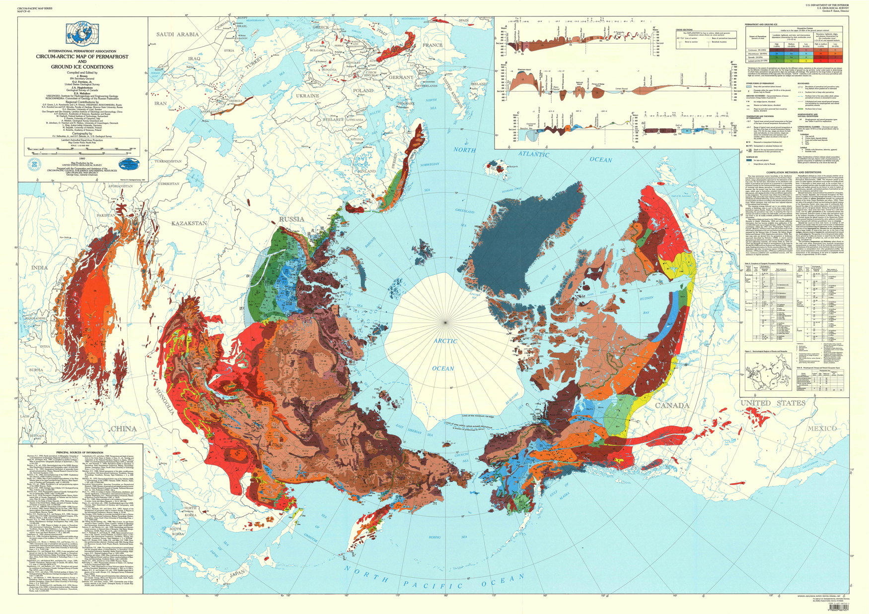
Notes:
Map of Northern Hemisphere Permafrost: 1997
Map of permafrost compiled in 1997 by the International Permafrost Assoc.
Permafrost is defined as soil, rock, and any other subsurface Earth material that exists at or below 0 °C for two or more consecutive years. Current maps of permafrost in the Northern Hemisphere (20° N to 90° N) are based on digitized versions of this map, compiled in 1997 by the International Permafrost Association. The map contributes to a unified international dataset that depicts the distribution and properties of permafrost and ground ice. Colors indicate permafrost extent, estimated in percent area.
While ground-based instruments can be used to obtain reliable measurements of permafrost at specific locations, it is difficult to make continuous measurements of permafrost because of its remoteness and vast distribution. Satellite observations from space, however, can cover broad areas and provide frequent measurements. The Soil Moisture Active Passive, or SMAP, mission is NASA’s first Earth-observing satellite mission designed to collect continuous global observations of surface soil moisture conditions as well as whether or not the water contained within the soil is frozen or thawed—called its freeze/thaw state—every 2-3 days at 3-40 km (~2-25 mi) spatial resolution. These data will help quantify the nature, extent, timing, and duration of landscape seasonal freeze/thaw state transitions as well as help detect permafrost thaw.

Slide 2
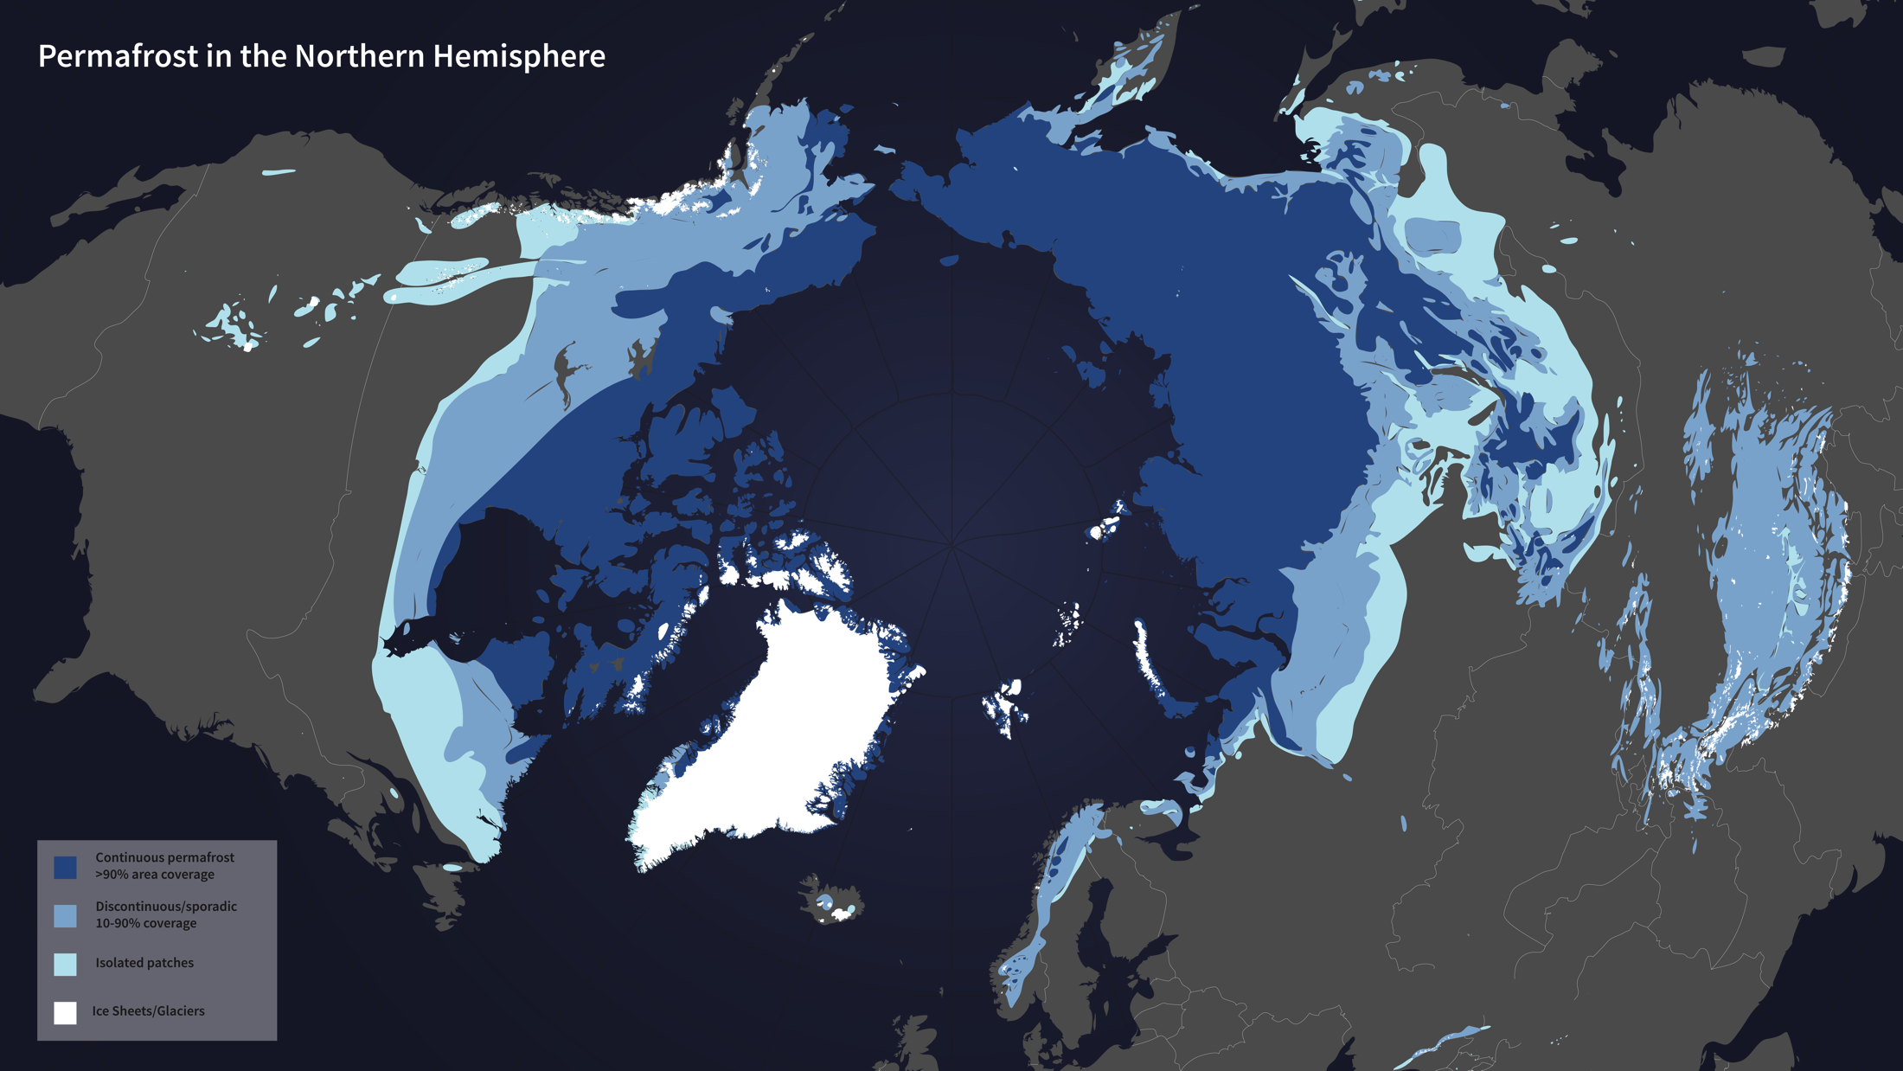
Notes:
Map of Northern Hemisphere Permafrost: 2012
Digitized version of a permafrost map originally compiled in 1997.
Permafrost is defined as soil, rock, and any other subsurface Earth material that exists at or below 0 °C for two or more consecutive years. This map, updated on February 21, 2012, depicts the distribution and properties of permafrost and ground ice in the Northern Hemisphere (20° N to 90° N). Based on an original map compiled in 1997 by the International Permafrost Association, this version has been digitized and simplified to show continuous permafrost, discontinuous/sporadic permafrost, isolated patches of permafrost, as well as ice sheets and glaciers.
While ground-based instruments can be used to obtain reliable measurements of permafrost at specific locations, it is difficult to make continuous measurements of permafrost because of its remoteness and vast distribution. Satellite observations from space, however, can cover broad areas and provide frequent measurements. The Soil Moisture Active Passive, or SMAP, mission is NASA’s first Earth-observing satellite mission designed to collect continuous global observations of surface soil moisture conditions as well as whether or not the water contained within the soil is frozen or thawed—called its freeze/thaw state—every 2-3 days at 3-40 km (~2-25 mi) spatial resolution. These data will help quantify the nature, extent, timing, and duration of landscape seasonal freeze/thaw state transitions as well as help detect permafrost thaw.

