Slide 1
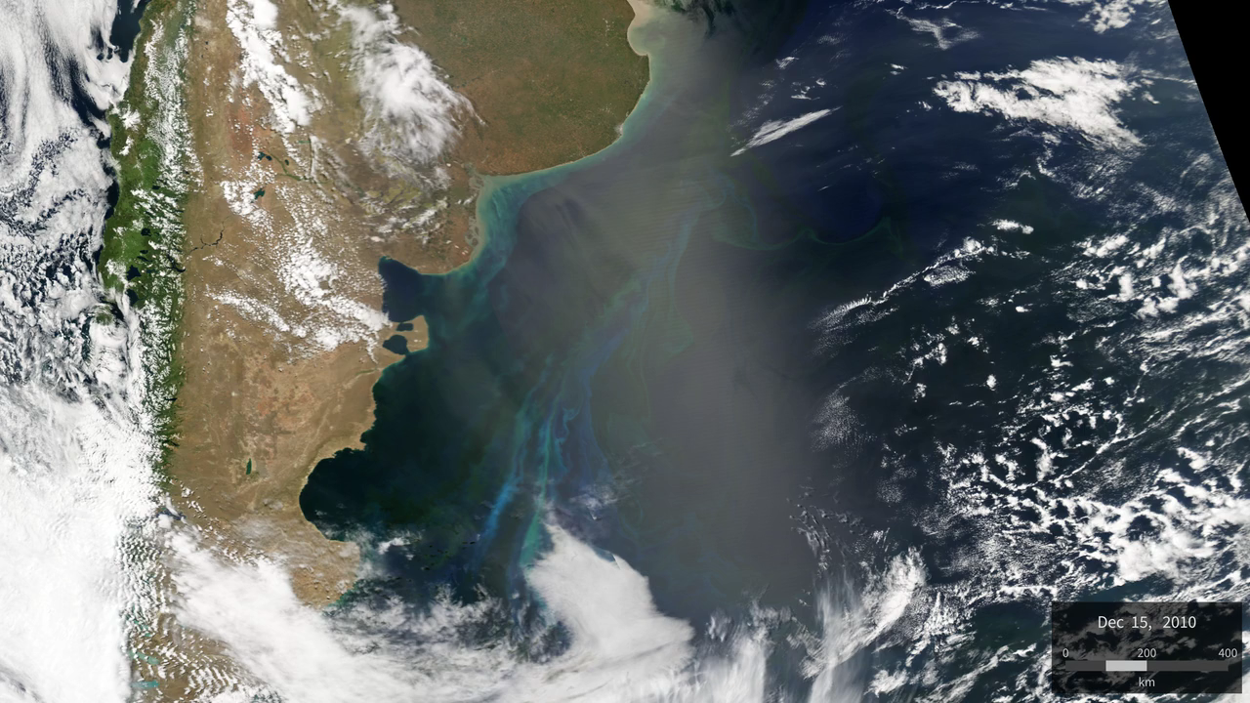
Notes:
Coccolithophores Near the Patagonia Shelf
Coccolithophores, a type of phytoplankton, are one-celled, microscopic marine plants that live in large numbers throughout the upper layers of the ocean. They surround themselves with minute calcium carbonate plates called “coccoliths,” which are highly reflective such that populations of these plants can be seen from space. Near the Patagonia Shelf, located east of Argentina and Uruguay, ocean waters thrive with high concentrations of microscopic phytoplankton—e.g., coccolithiphores, dinoflagellates, and diatoms to name a few. That is because in this region the warm, saline, southward-flowing Brazil Current flows past and mixes with the cool, less-saline, nutrient-rich northward-flowing Falklands/Malvinas Current, creating an ideal environment for biological productivity. Scientists use true color satellite images like these, taken by Aqua/MODIS from December 15, 2010 to February 15, 2011, to observe the recurring coccolithophore blooms in the Patagonia Shelf region and study the impacts of ocean acidification on these microscopic organisms. Imagery from these two months shows a coccolithophore bloom (turquoise) near the shelf break. The shelf's unique ecosystem supports important fisheries in the region, providing a favorable reproductive habitat for anchovies and sardines.
Satellite: Aqua
Instrument: MODIS

