Slide 1
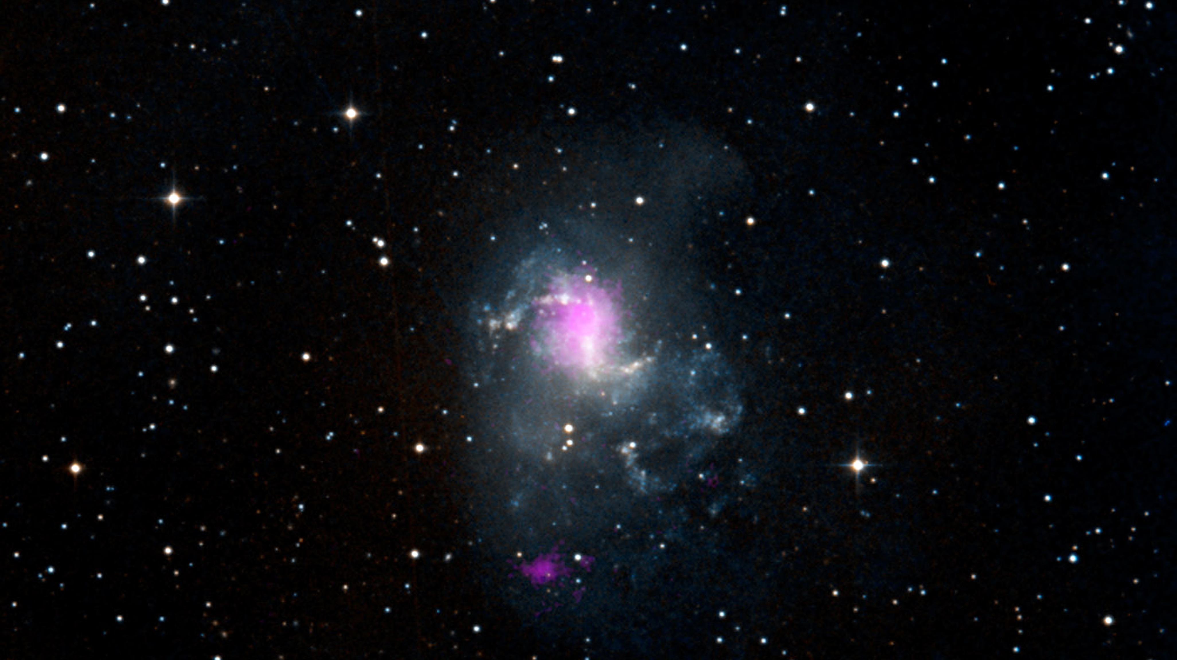
Notes:
Topsy Turvy Black Holes
The magenta spots in this image indicate two black holes in the spiral galaxy called NGC 1313, the Topsy Turvy galaxy. Both black holes belong to a class called ultraluminous X-ray sources, or ULXs. The magenta X-ray data come from NASA's Nuclear Spectroscopic Telescopic Array (NuSTAR) and are overlaid on a visible image from the Digitized Sky Survey.
ULXs consist of black holes actively accreting, or feeding, off material drawn in from a partner star. Astronomers are trying to figure out why ULXs shine so brightly with X-rays.
NuSTAR's new high-energy X-ray data on NGC 1313 helped narrow down the masses of the black holes in the ULXs: the black hole closer to the center of the galaxy is about 70 to 100 times that of our sun. The other black hole is probably smaller, about 30 solar masses.
The Topsy Turvy galaxy is located about 13 million light-years away in the Reticulum constellation.
Credit: NASA/JPL-Caltech/IRAP
Source: (image and caption) http://www.nasa.gov/mission_pages/nustar/multimedia/topsy-turvy-black-holes-20131126.html#.UvKB2vZ8PqA
(full story) http://www.nasa.gov/jpl/nustar/black-holes-20131126.html#.UvK73_Z8PqD
December 9, 2013

