Slide 1
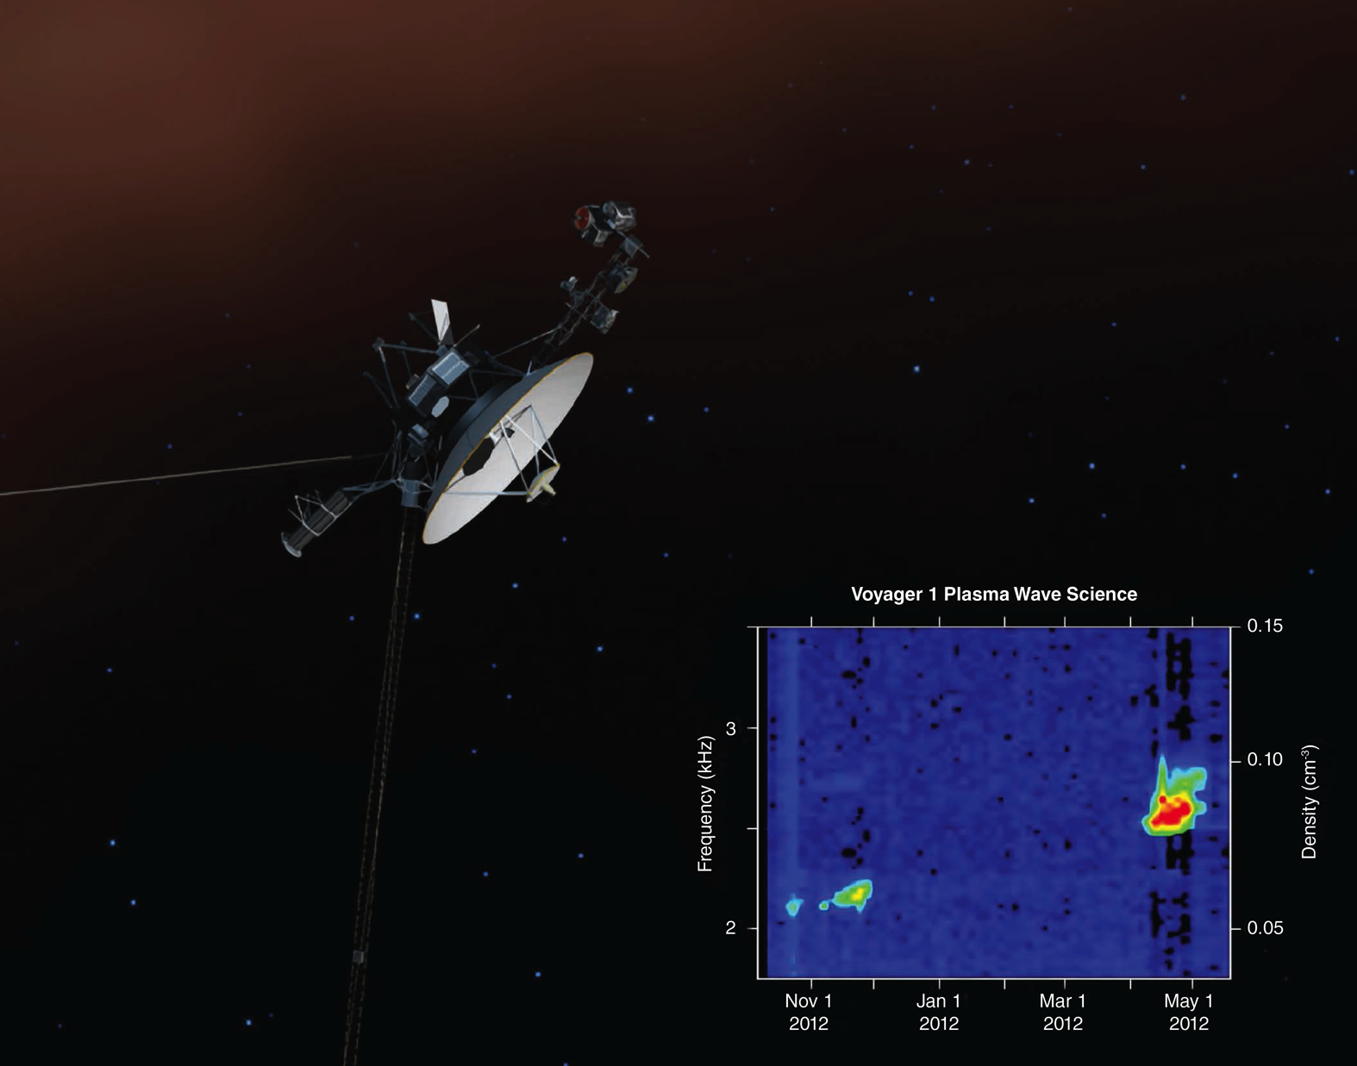
Notes:
At 122 times our distance from the sun, NASA's Voyager 1 spacecraft is the first human-made object to leave the heliosphere, the far-reaching extended atmosphere of the sun. Launched in 1997, Voyager 1 is traveling away from Earth at a speed of about 340 million miles (540 million kilometers) per year. In the summer of 2012, Voyager 1 started its journey into interstellar space, or the space between stars. This artist's concept depicts Voyager 1 exiting the heliosphere and entering the interstellar medium (brown hue at the top of the image).
When Voyager 1’s Plasma Wave Subsystem detects vibrations it allows scientists to characterize the plasma, or ionized gas, the spacecraft is embedded in. From October to November 2012 and again from April to May 2013, Voyager 1's plasma wave instrument detected vibrations caused by previous explosions on the sun. The inset graph shows the frequency of the waves, which is directly related to the plasma density. The high density clearly indicates that Voyager 1 is embedded in “cold” interstellar plasma, left over from the death of nearby giant stars millions of years ago, which dominates interstellar space. Through extrapolation of measured plasma densities from both events, teams of scientists determined that Voyager 1 first entered interstellar space in the summer of 2012. To listen to the audio version of the oscillations detected by Voyager 1, visit: www.nasa.gov/voyager. Its increasing pitch indicates increasing interstellar plasma density over time.

