Slide 1
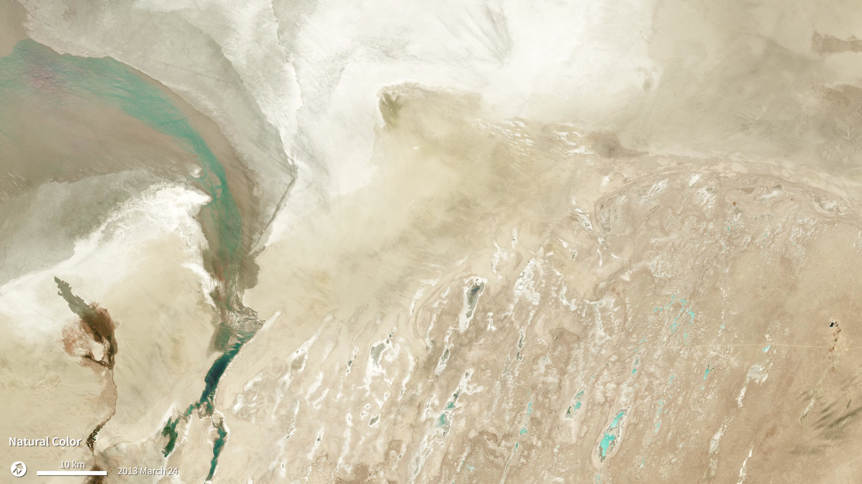
Notes:
The presence of high, thin cirrus clouds can be hard to detect and their shadows can interfere with satellite observations. Even satellite sensors designed to “see” beyond the visible spectrum struggle to detect them. Landsat-8’s Operational Land Imager (OLI) can detect these clouds better than previous Landsat sensors because in addition to measuring visible and infrared light in similar ranges to its predecessors, it also includes a shortwave infrared band (band 9)—which is useful for cirrus cloud detection. For example, the natural-color OLI image of the Aral Sea from March 24, 2013 shown here appears to have been taken on a relatively clear day. When viewed in the cirrus-detecting band alone (grayscale image) however, bright white clouds appear. The point of the cirrus band is to alert Landsat users to the presence of cirrus clouds so they know that the data in the pixels under the clouds could be slightly askew. Scientists could then use images taken on a cloud-free day, or they could correct the data from the other spectral bands to account for the cirrus clouds.

