Slide 1
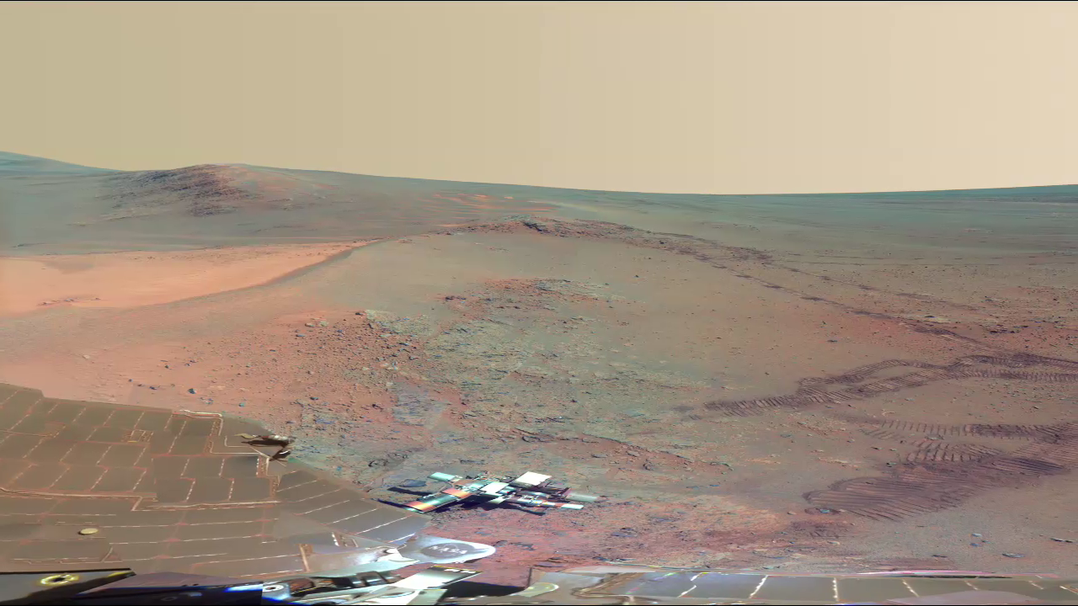
Notes:
A new full-circle view from the panoramic camera (Pancam) on NASA's Mars Exploration Rover Opportunity, taken between October 21, 2011 and May 8, 2012, shows the ruddy terrain that surrounded the long-lived explorer during recent Martian winter months. Opportunity was stationary for four months on a northward-sloped outcrop—a safe place to angle the rover’s solar panels toward the Sun in the northern sky during Southern Hemisphere winter. The science team named the site “Greeley Haven,” after team member Ron Greeley.
North is at the center of the image. On the far left at the horizon is Rich Morris Hill. Bright wind-blown deposits on the left are banked up against the Greeley Haven outcrop. Fresh rover tracks can be seen extending from the south, with a turn-in-place and other maneuvers evident. The interior of Endeavour Crater—blasted billions of years ago—can been seen just below the horizon in the right half of the scene.

