Slide 1
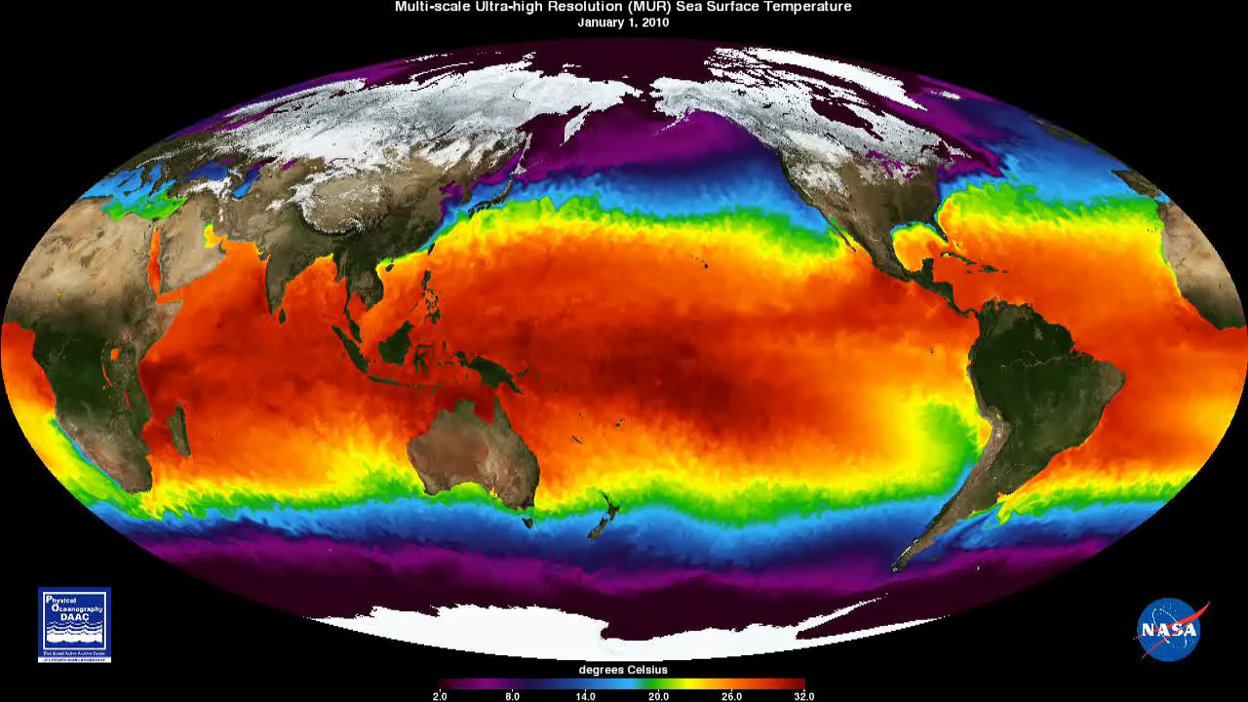
Notes:
Mapping the World’s Sea Surface Temperatures in Ultra-high Resolution
This animation from January 1, 2010, to December 31, 2011, shows global Sea Surface Temperatures (SST) at 1-km resolution. The Multi-scale Ultra-high Resolution (MUR) SST dataset combines data from the Advanced Very High Resolution Radiometer (AVHRR), Moderate Resolution Imaging Spectroradiometer (MODIS), and Advanced Microwave Scanning Radiometer for EOS (AMSR-E) instruments. Watch how Western Boundary Currents—fast-flowing currents that flow on the west side of ocean basins—such as the Gulf Stream and Kuroshio Current (near Japan) carry warm water from the tropics poleward. Additionally one can see the major upwelling areas (cooler temperatures) of the world's oceans associated with the California, Peruvian/Chilean, and Namibian/South African coasts.
Credit: NASA Jet Propulsion Laboratory
Source: podaac.jpl.nasa.gov/AnimationsImages/Animations
Short description: This animation from January 1, 2010, to December 31, 2011, shows global Sea Surface Temperatures (SST) in ultra-high resolution.

