Slide 1
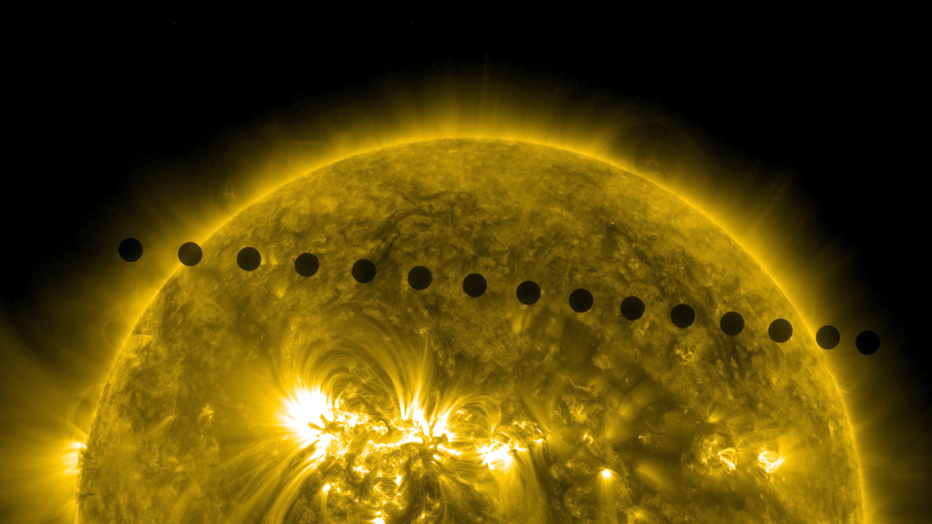
Notes:
Visions of Venus
On June 5-6, 2012, NASA's Solar Dynamics Observatory (SDO) captured beautiful, high-definition images of an astronomical event that occurs only twice every hundred years or so: the transit of Venus, when the planet passes directly between the sun and Earth. Such images could not have been envisioned when a ground telescope was first used to see the transit in 1639. Indeed, the imagery even improves on that captured during the last transit in 2004, before SDO was in orbit. During the event, scientists used the precise details about the position of Venus and the sharpness of its edges to help calibrate space telescopes, ensuring even better observations in the future.
Credit: NASA/Goddard Space Flight Center Scientific Visualization Studio
Source: http://svs.gsfc.nasa.gov/vis/a010000/a010900/a010996/
Short description:
On June 5-6, 2012, NASA's Solar Dynamics Observatory (SDO) captured beautiful, high-definition images of an astronomical event that occurs only twice every hundred years or so: the transit of Venus.

