Slide 1
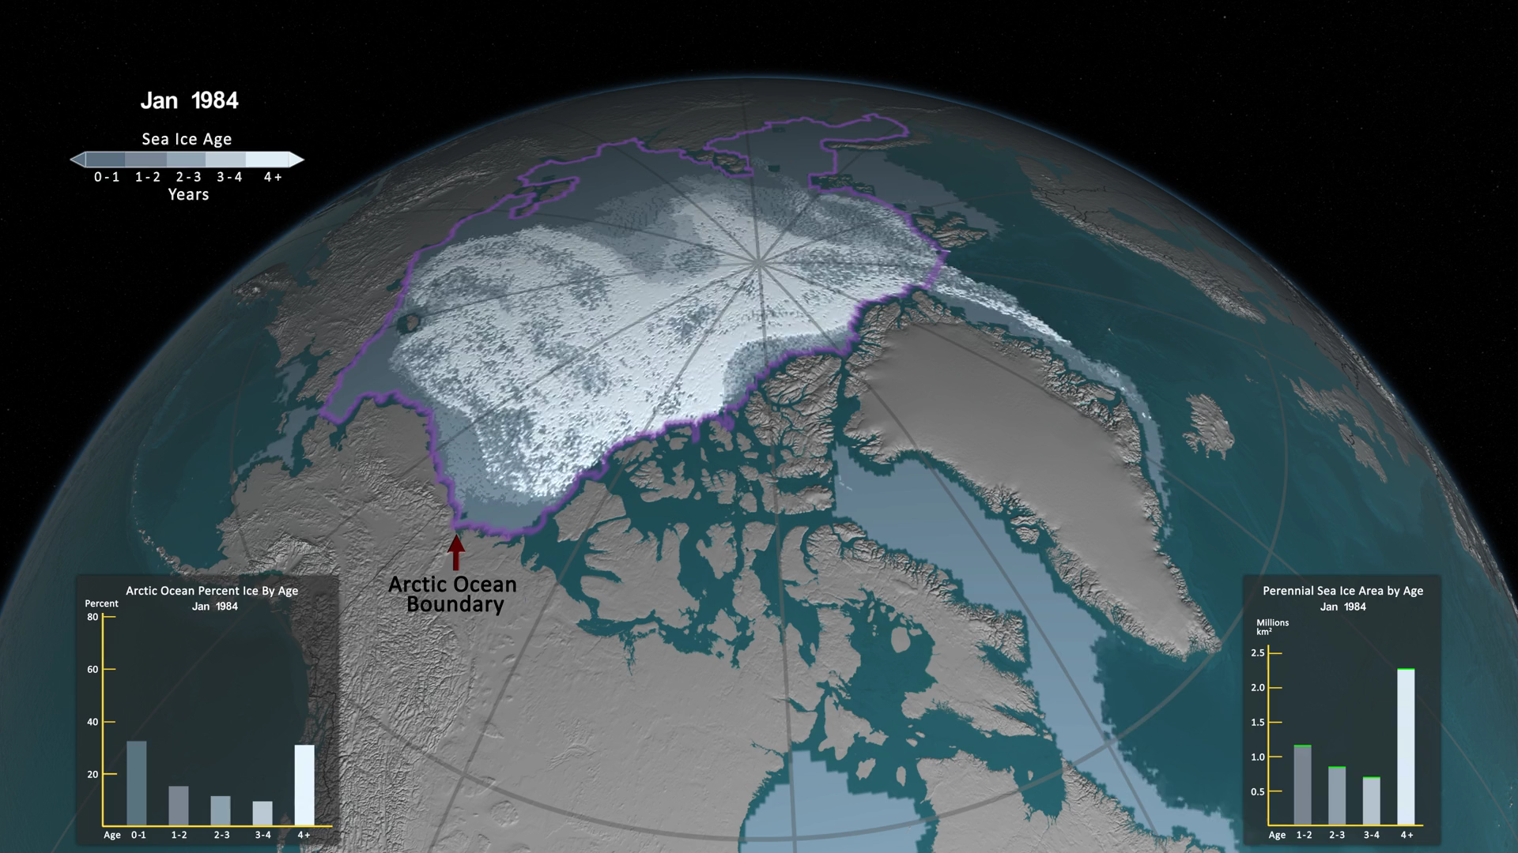
Notes:
Arctic Sea Ice Age: 1984 - 2016
One significant change in the Arctic region in recent years has been the rapid decline in perennial sea ice. Perennial sea ice, also known as multi-year ice, is the portion of the sea ice cover that has survived at least one summer melt season. Perennial sea ice may be as old as nine years, or even more, and represents the thickest component of the sea ice.
This visualization shows the seasonal variability of the age of the sea ice, week by week, between 1984 and 2016. Interannual changes are also evident. The age of the sea ice is depicted by different colors. Younger sea ice, or first-year ice, is shown in a dark shade of blue while the ice that is four years old or older is shown in white.
A graph in the lower, right corner the quantifies the change over time by showing the area in millions of square kilometers covered by each age category of perennial sea ice. This graph also includes a memory bar - the green line that represents the current maximum value seen thus far in the animation for the particular week displayed.
The graph in the lower left corner quantifies the sea ice age as a percent of total ice cover in the Arctic Ocean. The area included in the Arctic Ocean, and thus the graph, is outlined in lavender.

