Slide 1
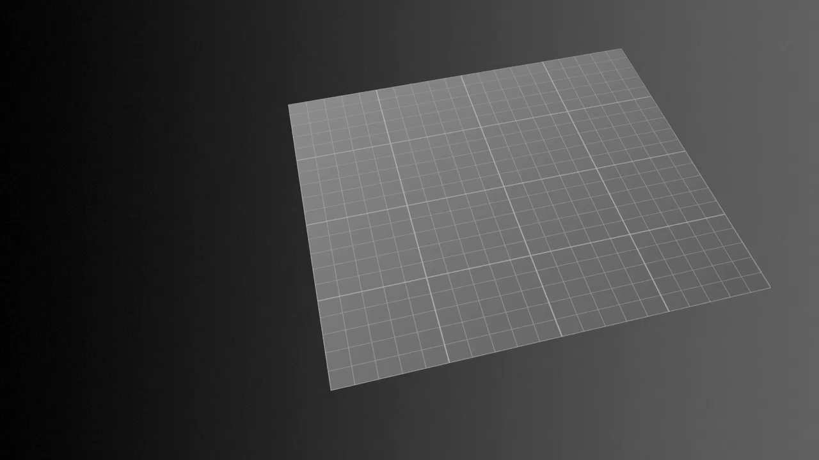
Notes:
How LRO Will Find Safe Landing Sites on the Moon:
Astronauts will want to avoid places with steep slopes that could tip the spacecraft, so LRO includes a laser ranging system that will build an elevation map to show the contours of the polar surface. The instrument, called the Lunar Orbiter Laser Altimeter (LOLA), records the time it takes for a laser pulse to travel from the spacecraft to the lunar surface and back to calculate the height of the lunar terrain. After a year in orbit aboard LRO, LOLA will have created an elevation map of the polar regions that is accurate to within a half-meter (20 inches) vertically and 50 meters (about 160 feet) horizontally.
LRO will also use data from another instrument that measures temperatures to double-check the safe zone map. Temperatures change more rapidly in areas with loose materials (lots of rocks). By analyzing how quickly temperatures change in potential landing zones, planners using the instrument, named Diviner, can rule out areas that appear smooth but actually are likely to be rocky.
Credit: NASA/Goddard Space Flight Center Scientific Visualization Studio
Source: http://svs.gsfc.nasa.gov/vis/a000000/a003500/a003533/
Short description:
After a year in orbit aboard LRO, LOLA will have created an elevation map of the polar regions of Earth's moon; that is accurate to within a half-meter vertically and 50 meters horizontally. The map will be used by astronauts, to identify safe landing zones free of large boulders and craters.

